Slide 1



Welcome to SLU

Slide 2
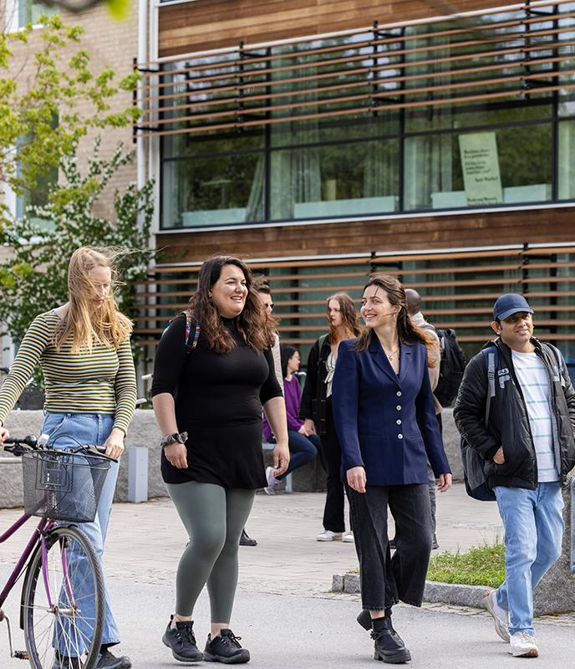

New at SLU
- What do I need to do?
Stay updated via the student web
Activate your SLU student account
Pick up your access card (after
registration in Ladok student)
Get started with SLU’s study systems
Notes:
Script :
Stay updated via the student web
The student web is where we publish information for SLU students, including information on the support available during your studies.
Activate your student account
To be able to register on your course or programme, you need to activate your SLU account.
https://www.slu.se/en/student-web/support-and-services/it-support/my-slu-account/
Get started with SLU’s digital study systems
Once you have activated your SLU student account, you have access to several digital tools, systems and programs for your studies at SLU. Log in and familiarise yourself with these before the course starts.
Pick up your access card
Once you have registered on an SLU course, you will receive an email informing you that you can pick up your access card from the service centre. It can take up to two days from registration before you receive this email.

Slide 3


Good to know
- Practical information
Mecenat - student discount card
Student insurance - Kammarkollegiet
Your rights and responsibilities
Call 112 if you need an ambulance,
fire and rescue services or the police.
Notes:
Script
Mecenat student card
Joining a student union is the easiest and the fastest way to get your Mecenat card.
As an international student at SLU, you are eligible for a Mecenat card, free of charge. The Mecenat card is a student card which offers a variety of discounts, including for public transportation and train companies throughout Sweden.
https://www.slu.se/en/student-web/studies/new-student/checklist-autumn/checklist-international-students/
Insurance
All students at SLU are covered by student insurance at no extra cost. Make sure you know what the insurance covers by reading the information on the student web: https://student.slu.se/en/rules-rights/rights-and-responsibilities/insurances/
The insurance is provided by Kammarkollegiet, a government agency.
Rights and responsibilities
Read about your rights and responsibilities on the student web: https://www.slu.se/en/student-web/rules-rights/rights-and-responsibilities/
112 is the emergency number for ambulance, fire and rescue services and the police.

Slide 4


Gender equality and equal opportunities
- What applies at SLU?
SLU should be characterised by an open attitude and respect for people’s differences and equal value. This means that all students must have the same opportunities. Discrimination and harassment are not permitted.
Notes:
Script
https://student.slu.se/en/rules-rights
Here, you will find information about who to contact if you experience discrimination or harassment during your studies at SLU.

Slide 5

INCIDENT
Notes:
Script
Via the warning triangle on the Student Web start page, you can find information on what to do if a serious incident occurs. This section includes information on:
Work environment
Reporting harassment and victimization
In case of crisis or accident – crisis management team
In the event of fire
File a premises fault report
Report environmental matters
Where you can find efibrillators at SLU
Contact a student mediator
If you fall ill or get injured
https://www.slu.se/en/student-web/support-and-services/in-case-of-problems-incidents-or-emergencies/

Slide 6


Support for students
Study and career counselling –
studyguidance@slu.se
Studying with a disability –
disability@slu.se
SLU University Library –
library@slu.se
Student health care and university chaplaincy
Notes:
Script
Study and career counselling
Having thoughts about your studies or your future? The study and career counsellors at SLU are available for support throughout your time here.
Studying with a disability
You can study at SLU even if you have a disability such as dyslexia, ADHD or mental health issues. You can apply for study support for students with disabilities, and the support will be adapted to your needs. A study support coordinator will create a plan with you.
SLU University Library
SLU University Library offers support on academic writing, searching and reference management.
Student health services and the university chaplaincy
At SLU, we want our students to be well, and at all SLU sites you have access to some form of student health services. You can also get support through the university chaplaincy.

Slide 7
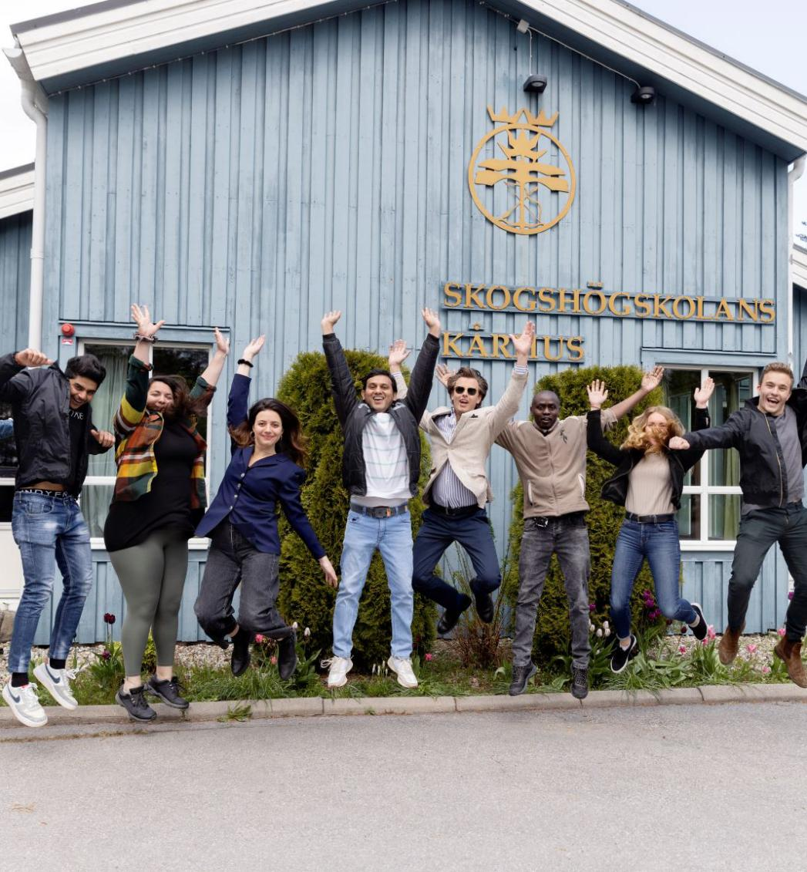
Student unions
The student unions at SLU are run by students, for students. Their main role is to monitor and influence the quality of education. The unions also play an important social role by organising a wide range of activities.
Notes:
Script
The student unions
At SLU there are seven different student unions, and students can join one union depending on the programme they are enrolled in. The student unions are independent from the university.

Slide 8
Contact
Feeling overwhelmed?
That is completely normal, everything will be fine!
Programme director of studies
Name
Email
Phone number

