Slide 1
How to use the SLU presentation (hidden slide) 1/3
You can use the presentation as is and add slides that describe your work or your part of the organisation in more detail.
You can also copy the slides you need from this presentation and add them to your own.
In the notes section of the slides, you will find a script that you can use as a basis for your presentation. On many slides, there are links to more information on the topic covered. Feel free to add your own notes to the script as an aid.

Slide 2
How to use the SLU presentation (hidden slide) 2/3
If you are planning to email your presentation, you can reduce the file size by selecting Compress Pictures… and then selecting one of the options E-mail (96 ppi) or Web (150 ppi).
If you are sharing the presentation with others, e.g. students, the public, colleagues, within or outside SLU, you need to check that the file fulfils the accessibility criteria using the Check Accessibility command.

Slide 3
How to use the SLU presentation (hidden slide) 2/3
Don’t forget our films, they are an excellent addition to your SLU presentation:
https://internt.slu.se/en/support-services/administrative-support/communication/material-templates/ready-to-use/films-about-slu/
Make sure to download the film to the folder where your ppt file is stored. Play the film from the folder to avoid problems due to e.g. a poor connection.

Slide 4
Science and education for sustainable life
Notes:
My name is ….. and I work at … I’m going to introduce you to SLU with an overview.
SLU is a university we like to describe in three sentences:
We are a world-class international university.
We take on fundamental issues that affect all of us.
We make the world a better place.

Slide 5

VISION
SLU plays a key role in development for sustainable life, based on science and education.
Notes:
Our Vision:
SLU plays a key role in development for sustainable life, based on science and education.
For more on our mission statement and our goals, strategies and values, see: https://www.slu.se/en/about-slu/organisation/mission-vision-objectives-strategies/

Slide 6

MISSION STATEMENT
SLU conducts education, research and environmental monitoring and assessment in collaboration with society at large.
Through our focus on the interaction between humans, animals and ecosystems and the responsible use of natural resources, we contribute to sustainable societal development and good living conditions on our planet.
Notes:
This is the SLU mission statement.
In other words, you could say that SLU is a world-class international university with research, education and environmental monitoring and assessment within the sciences for a sustainable life.
We focus on the very foundations of our existence:
clean water,
living landscapes,
sustainable food production,
high standards of animal welfare,
sustainable cities
and bio raw materials that can replace fossil fuels and materials.
We bring together people who have different perspectives, but one and the same goal – to create the best conditions for a sustainable, thriving and better world.
For more on our mission statement and our goals, strategies and values, see: https://www.slu.se/en/about-slu/organisation/mission-vision-objectives-strategies/

Slide 7
PRESENTATION OF SLU
We take on fundamental issues that affect all of us
We are a world-class international university
We make the world a better place
A climate-neutral SLU by 2027
Education
Research
Environmental monitoring and assessment
Collaboration
SLU in Sweden, Infrastructure, Organisation, SLU in figures etc.
Notes:
You can use this hidden slide to show the audience your structure and move or remove chapters in accordance with the slides you choose to include.
To make the slide visible in your presentation, right click on it and de-select “Hide slide”.

Slide 8
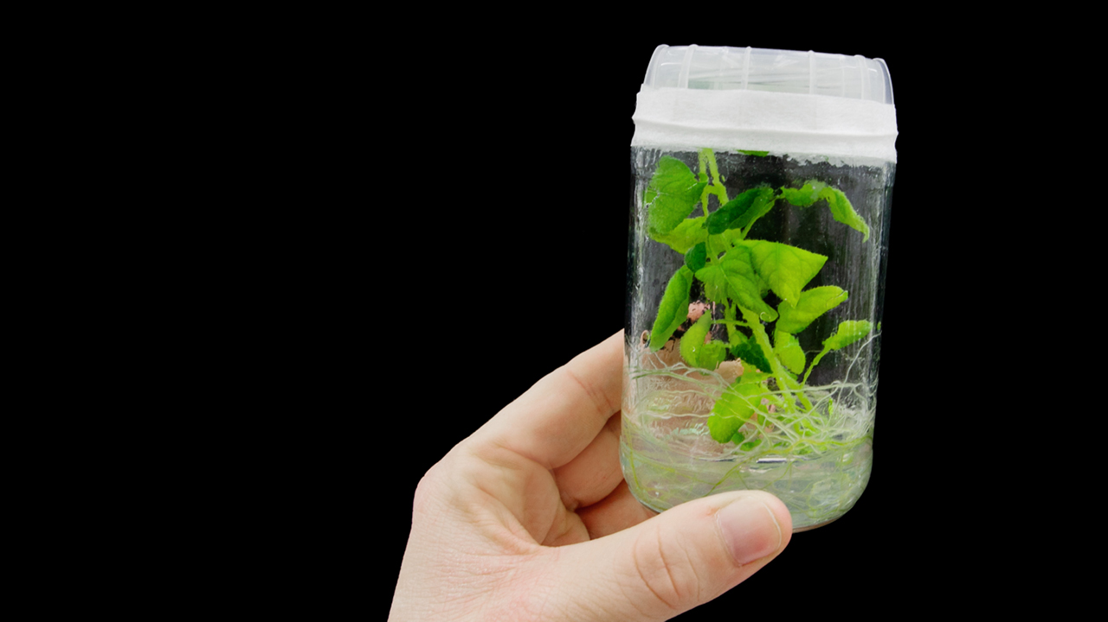
WE ARE A WORLD-CLASS INTERNATIONAL UNIVERSITY
High scientific quality in our fields
One of the world’s top 200
Number 49 of young universities worldwide
Notes:
SLU is a research-intensive university – about 70 % of the turnover goes to research and doctoral education.
Our scientists contribute to more than 2 000 scientific articles per year. More than 75 % of them are co-published with universities in other countries. The share of scientific articles published that belong to the 10 most cited per cent in their respective subject field is just above 16 per cent.
In international comparisons, SLU ranks very highly. Some examples of SLU’s position in different fields in international university rankings.
QS Rankings
Third best university in the world for agriculture and forestry, and 29th for veterinary science, 2025.
The CWTS Leiden Ranking
The CWTS Leiden Ranking (2024) ranks universities according to various measures of the scope and quality of scientific publishing. In terms of the number of publications that are among the top 10 percent in their field (P top 10%), SLU ranks 5th among Swedish universities.
National Taiwan University Rankings
SLU by area and subject: 14th place worldwide for plant and animal sciences, 57st for agriculture and 25th for environment and ecology, 2025.
Shanghai Ranking Lists
The ARWU overall ranking places SLU among the 401–500 best universities worldwide in 2025.
SLU performs well in the GRAS academic subject ranking 2025, particularly for agricultural sciences (rank 8), ecology (rank 24), and veterinary sciences (rank 35).
Times Higher Education Ranking
THE World University Rankings place SLU in the 351–400 interval, 2026.
SLU ranks 49th among the world’s best young universities, making it the second-best young university in Sweden, 2024.
Times Higher Education Impact Ranking
As of 23 June 2025, we are now in the top 101–200 bracket of the 2526 higher education institutions evaluated by the Times Higher Education Impact Rankings 2025. We rank 58th for SDG 2 – zero hunger, 3rd for SDG 13 – climate action, and 59th for SDG 14 – life below water.
Read more at: https://www.slu.se/en/about-slu/about-the-university/university-ranking/

Slide 9
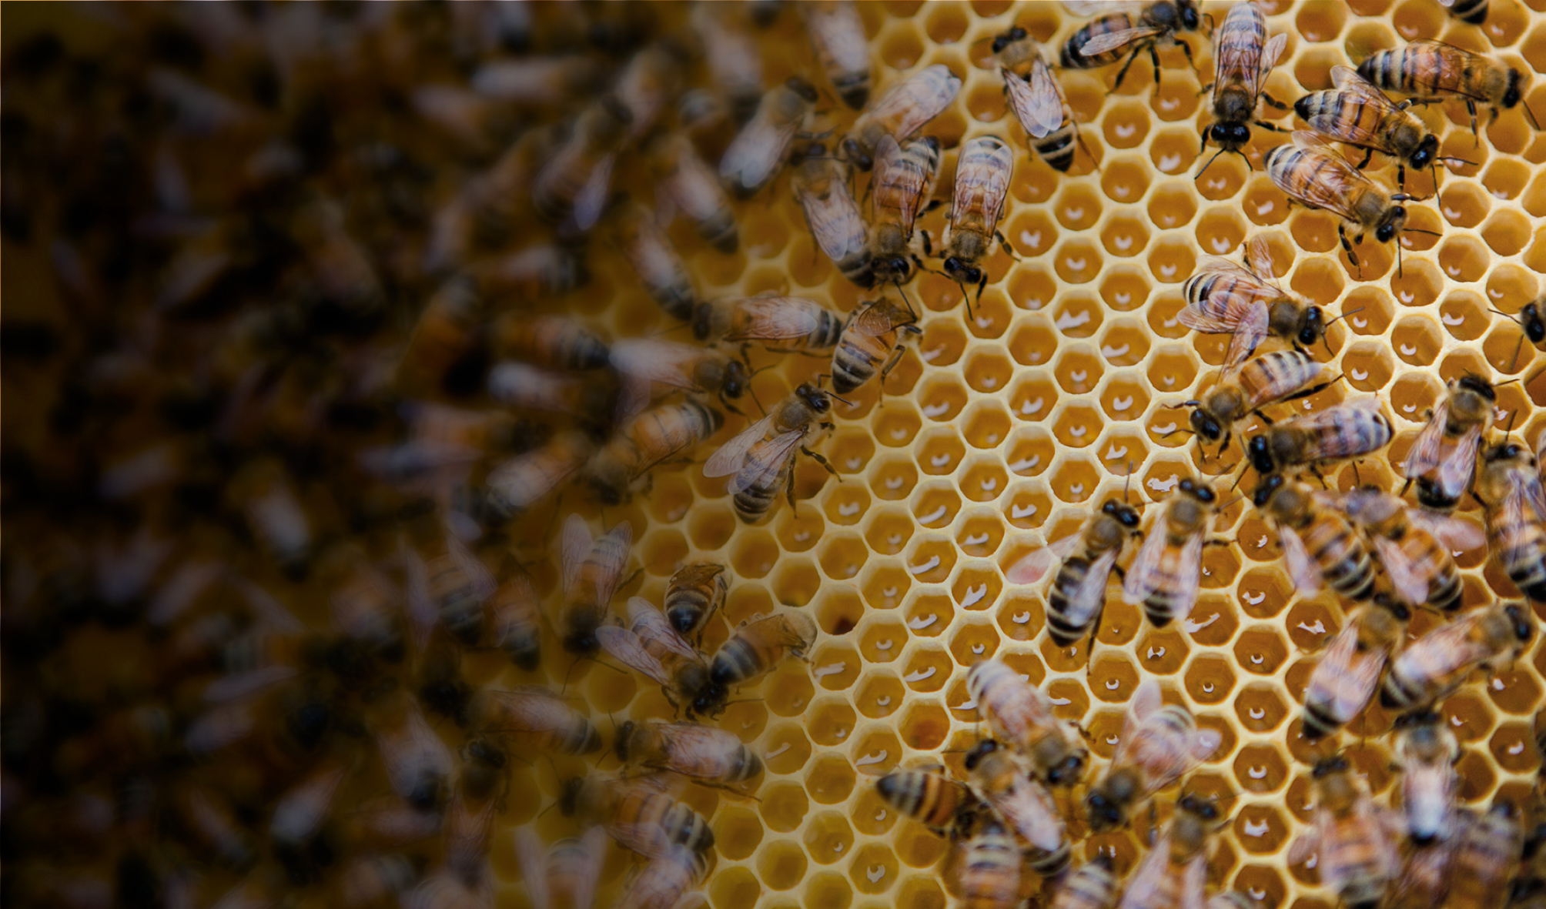
COLLABORATE WITH US
At SLU, we are convinced that collaboration is a win-win strategy. This is why we often collaborate with other public authorities, organisations and businesses to jointly achieve goals and results that are only possible if we work together.
Notes:
SLU collaborates extensively with various stakeholders, nationally and internationally. This collaboration is an integral part of our research, teaching and environmental monitoring and assessment. Our collaboration partners are public bodies, interest organisations, businesses, etc. This ensures that the knowledge produced at SLU is relevant for tackling society’s challenges, today and tomorrow.
Collaborating helps us connect theory with practice and improves the quality of our research, teaching and environmental assessment. It also helps us make our knowledge available to those who need it.
Researchers and environmental assessment analysts who collaborate as part of their daily work account for the majority of our collaboration efforts.
There are also structures and investments in place to promote collaboration, such as:
several collaborative centres and ‘Future’ platforms with collaboration as one of their tasks
around 20 researchers/lecturers with a special collaboration assignment (‘collaboration specialists’)
extensive collaboration with actors in low-income countries through SLU Global
support structures for innovation and commercialisation through SLU Holding
professional development and training
dissemination of knowledge – reports, conferences, meetings, fairs and through digital channels such as the web, newsletters, pods and film
Read more about collaboration at SLU at https://www.slu.se/en/collaboration/

Slide 10
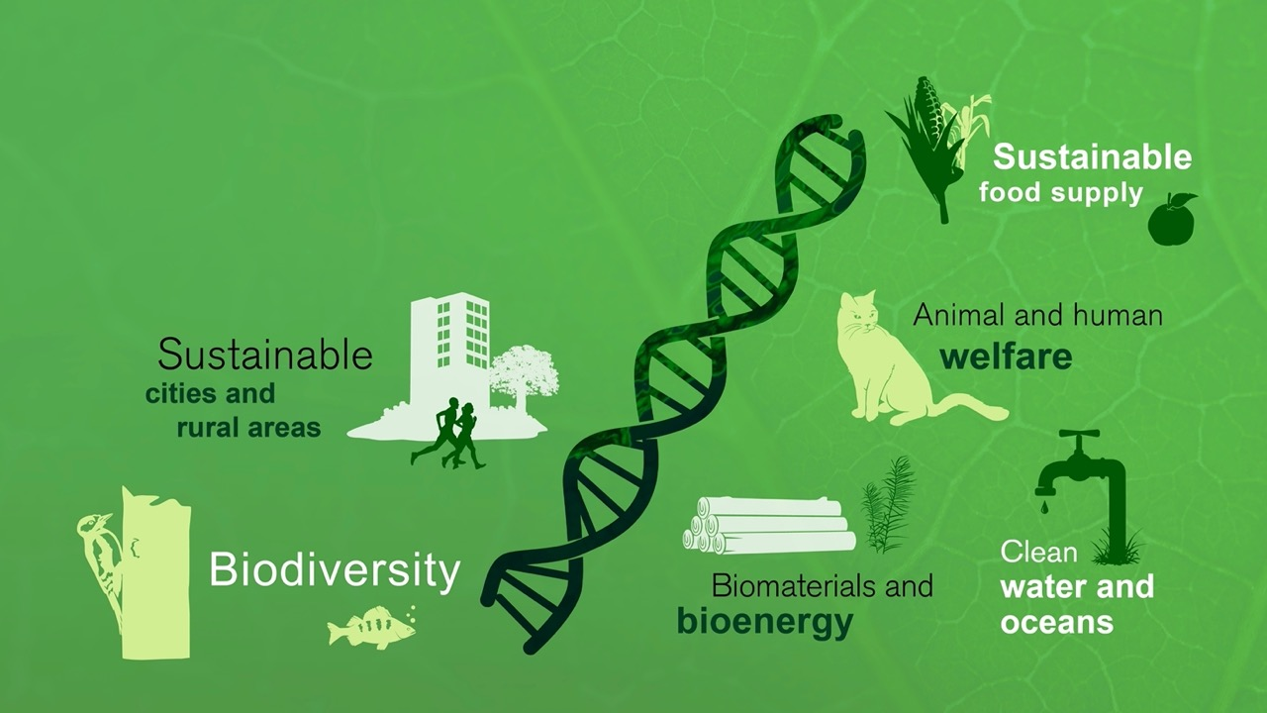
WE TAKE ON FUNDAMENTAL ISSUES THAT AFFECT US ALL
Notes:
SLU works on issues that are fundamental to us as human beings and concern every living thing on earth.
Here are a few examples:
Sustainable food supply For example adapting to climate change, producing new foods, more environment and climate-friendly food production, urban cultivation, digitilised cultivation, food waste, health issues, consumer issues, business administration and entrepreneurship in the food industry.
Clean water and oceans For example environmental toxins, eutrophication, land-based fish farming the wellbeing of fish stocks in water, drinking water, and problems with drought and flooding.
Sustainable urban and rural areas For example green roofs, urban cultivation, GIS (Geographic Information System) maps for children, adapting buildings to cope with extreme weather and rising sea levels.
Biomaterials and bioenergy Materials and energy that can be used to replace fossil-based products and raw materials, such as starch/cellulose instead of plastics and using bioenergy as a fuel.
Animal and human welfare For example antibiotic resistance, zoonoses (infectious diseases transmitted between animals and humans), food and health, green spaces in cities, outdoor life, animal welfare, the importance of companion animals to humans, garden rehabilitation, animals in healthcare.
Biodiversity For example predator issues, elk management, invasive plants and animals, how we manage forests and land, the mapping of species and endangered species.

Slide 11

WE MAKE THE WORLD A BETTER PLACE
Some important areas: climate change, sustainable cities, global health, biodiversity etc.
Contributing to the development of low-income countries
Data and analyses on which to base environmental decisions
Climate-neutral by 2027!
Notes:
Our knowledge creates the right conditions for a sustainable, thriving and better world. SLU is contributing to the achievement of the global sustainable development goals (Agenda 2030), both in Sweden and internationally.
Areas important to SLU are:
Climate change – agriculture and forestry must both be adapted to and contribute to mitigating climate change. We are developing sustainable solutions for water management and reducing greenhouse gas emissions.
Food supply – finding resource-efficient (socially, economically and environmentally) sustainable solutions for increasing global food production, through initiatives such as digitilisation and artificial intelligence.
Sustainable cities – to make plans for how to deal with the effects of climate change, such as extreme weather events and rising sea levels, and to develop green infrastructures to help contribute to the health and wellbeing of humans.
Bio-based economy – to move from a fossil-based to a bio-based economy requires new solutions and trade-offs, such as issues surrounding land use. Should we cultivate food, animal feed, fibre or energy crops and who decides?
Global health – for example, to reduce the risk of the spread of zoonoses and diseases carried by insects and cut down on the use of antibiotics in animal husbandry which could help slow down the development of resistance to antibiotics.
Biodiversity and ecosystems – environmental monitoring provides the information necessary for the management and re-creation of ecosystems both on land and in oceans and lakes.
Here are a few examples of what SLU is doing to make the world a better place:
SLU Global: Central unit that supports research and development projects in collaboration with scientists and universities in low-income countries.
Global Challenges University Alliance: SLU collaborates with agricultural universities around the world on the sustainability goals and Agenda 2030, for example on issues such as food supply, bioenergy, sustainable urban development and the climate.
Innovations based on information and expertise from SLU make a huge difference to society.
SLU’s environmental monitoring and assessment contributes by providing data and analyses on which to base decisions on environmental issues, both nationally and internationally.
The whole of SLU is environmentally certified in accordance with ISO 14001 and has the target of becoming climate-neutral by 2027.
For more on SLU and Agenda 2030, see: https://www.slu.se/en/about-slu/facts-visions-och-values/slu-and-agenda-2030/
For more on SLU Global, GCUA, see: https://www.slu.se/en/collaboration/international/

Slide 12
Our environmental objectives
SLU’S ENVIRONMENTAL OBJECTIVES
VISION: A CLIMATE-NEUTRAL SLU BY 2027
Notes:
SLU has environmental objectives in the areas of energy consumption, business travel, purchasing, education and environmental monitoring and assessment. There are also action plans for these objectives. In addition, SLU has the vision to be a climate-neutral university by 2027, the year we will celebrate our 50th birthday. To achieve that objective, we have identified 6 focus areas, some of which are directly linked to our environmental objectives.
There are annual follow-ups of the objectives and the vision: https://internt.slu.se/en/support-services/administrative-support/environment/
For energy consumption, the objective is reduced and more efficient use of energy in all our buildings, the ones we own and the ones we rent. This is done in cooperation with Akademiska hus, our main landlord. Also, according to this vision, all electricity and district heating and cooling are to come from fossil-free sources.
All SLU business travel must consider environmental factors. This includes reducing our emissions from air travel by 14 per cent annually, as per the Paris Agreement.
Procurement and purchasing at SLU should be climate-aware and take environmental considerations into account. One of the things we do is include requirements in procurements where possible. We also follow up agreements to ensure that suppliers live up to these requirements.
SLU’s main environmental impact is positive, e.g. through the degree programmes and courses we offer. All students participating in a degree programme at SLU will, with a view to their future professional roles, receive a good grounding for working with all dimensions of sustainability (financial, social, and environmental). We do this by integrating sustainable development in all programmes, and the view of our alumni is that they are given the tools they need to work with all three dimensions of sustainability in their professional life. That way, they can contribute to a better and more sustainable world.
Another of our objectives is to make environmental assessment data available on the Internet to enable decision-makers, public authorities, researchers and the public to use them more.
SLU owns several vehicles, from tractors and other agricultural machinery to passenger cars and ATVs. Our vision is that by the end of 2027, all SLU vehicles will run on non-fossil fuels.
Some of our carbon dioxide equivalent emissions are difficult to reduce to zero; for these, we are looking into ways of climate compensating for them long term and in a sustainable manner.

Slide 13
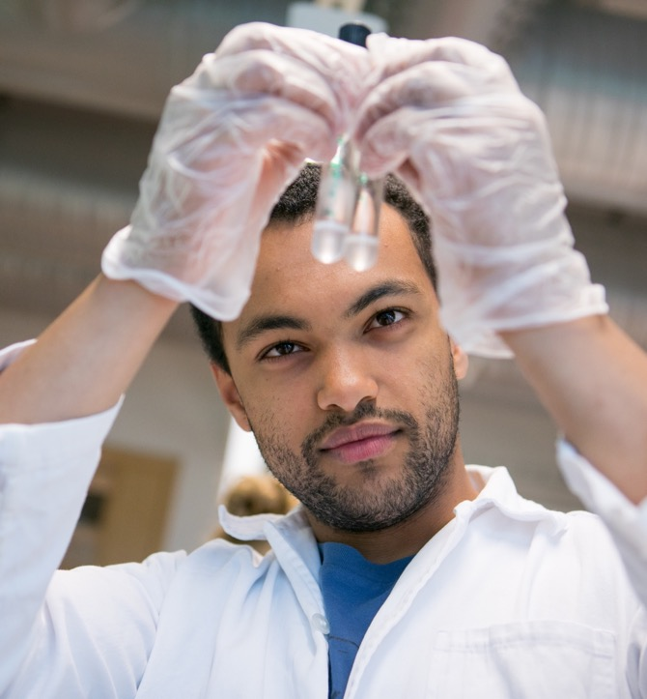
EDUCATION
Sustainability experts of the future
Some 50 degree programmes
Many popular international programmes
Notes:
SLU students are much sought-after on the labour market and often get jobs straight after graduating.
We offer some 50 degree programmes in natural sciences, social sciences, technology and the humanities.
We also offer professional programmes such as those that lead to qualifications as an engineer, veterinary surgeon, equine scientist, landscape architect, forestry manager and agronomist. But we also run other programmes such as Biology and Environmental Science and Sport and Companion Animals.
SLU offers many sought-after international Masters’ programmes, such as Horticultural Science and Sustainable Food Systems.
Read more at: https://www.slu.se/en/study/

Slide 14
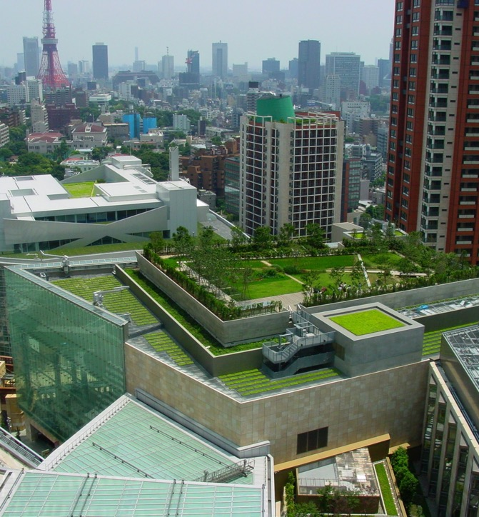
RESEARCH
In natural sciences, social sciences and the humanities
Transdisciplinary approach
Curiosity-driven basic research
Problem-solving studies
Notes:
We have expertise in the natural sciences, but also excellent research in the fields of humanities and social science, and we work with a transdisciplinary approach.
We combine strong, curiosity-driven basic research with more specific studies aimed at solving concrete problems, both locally and globally.
Some examples of socially beneficial research:
Artificial spider silk with potential for use in medical applications.
Climate-friendly rice that emits the minimum amount of the greenhouse gas methane during cultivation.
Chemical signals between animals, plants and microbes used to control pest insects in areas such as apple orchards.
Manual for urban densification
Read more: https://www.slu.se/en/research/

Slide 15
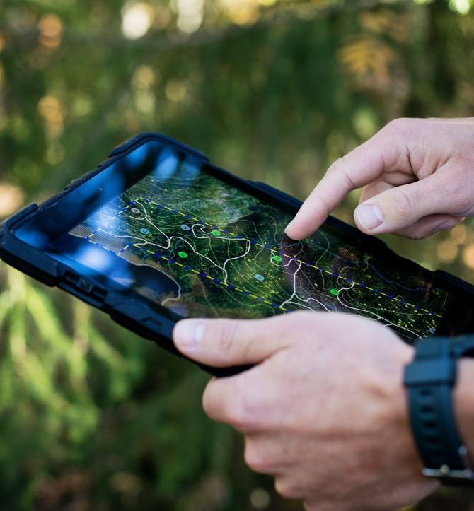
ENVIRONMENTAL ASSESSMENT
Keeping tabs on ecosystems
Monitoring Sweden’s land and water
Knowledge and decision support
Analyses and method development
Open data and web services
Citizen science
Notes:
SLU’s environmental monitoring and assessment collect knowledge about ecosystems, i.e. biological natural resources.
SLU is Sweden’s largest provider of environmental monitoring services and our expertise is in great demand. Our experts meet society’s need for up-to-date know-how on the sustainable use of ecosystems.
We fulfil the Swedish environmental goals and the global goals of Agenda 2030 through 12 environmental assessment programmes: Alpine/Arctic Landscapes, Forests, Agricultural Landscapes, Built Environment, Lakes and Watercourses, Coastal and Sea Areas, Eutrophication, A Non-Toxic Environment, Climate, Acidification, Biodiversity and Wildlife.
Environmental monitoring and assessment comprise:
Environmental monitoring of all of Sweden’s land and water environments, and follow-up of the EU fisheries policy.
Analysis of the data collected.
Knowledge in the areas concerned, such as decision-making support produced on demand to provide scientific evidence of the consequences of decisions taken by public authorities.
Method development for smarter and more efficient environmental assessment methods such as e-DNA, remote sensing methods, genomic methods and bioassays.
Open data and web services make multiannual environmental monitoring series and inventories available, e.g. the National Forest Inventory.
Delivering data for reporting on international environmental cooperation such as EU directives and international conventions, including representing Sweden in those contexts.
Citizen science: SLU is an important hub for voluntary reporting of nature observations in Sweden, with the largest being Artportalen (Swedish Species Observation System).
SLU’s environmental assessment is leading in Europe on the design of environmental monitoring methods and is world-leading in methods for forest inventory.
Read more: https://www.slu.se/en/environment/

Slide 16
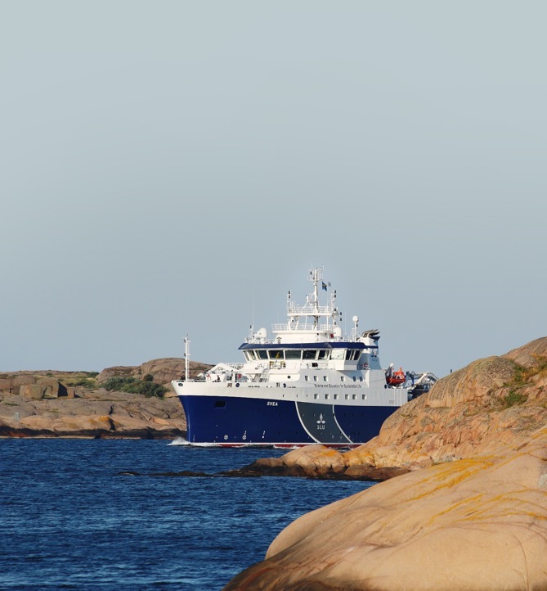
UNIQUE INFRASTRUCTURE
Photo: Hans C. Nilsson
Modern research vessel
University animal hospital
Research stations and experimental parks
Facilities for animal and plant research
Databases, biobanks and laboratories
Notes:
SLU has a comprehensive infrastructure which researchers both within and outside SLU can use.
Here are a few examples of our unique research infrastructure:
R/V Svea research vessel – one of the most modern research vessels in the world, R/V Svea is owned by SLU and was specially built for marine research and environmental monitoring. Operating begins in 2019.
University Animal Hospital (UDS) – the University Animal Hospital has many specialists in veterinary medicine in Uppsala. It is the only university animal hospital in Sweden.
Field research stations, such as Lönnstorp Research Station and Svartberget Experimental Forest.
Facilities for animal and plant research, such as the Swedish Livestock Research Centre in Lövsta and the Biotron in Alnarp.
Databases and biobanks: The Swedish National Gene Bankf or Vegetateively Propagated Horticultural Crops and soil, water and environmental data.
Laboratories: the Fish Genetics Laboratory at the Institute of Freshwater Research and the Tree Transformation Platform at Umeå Plant Science Centre.
SLU also coordinates the two national research infrastructures Swedish Lifewatch and the Swedish Infrastructure for Ecosystem Science (Sites).
For more on our research infrastructure, see: https://www.slu.se/en/research/research-infrastructures/

Slide 17

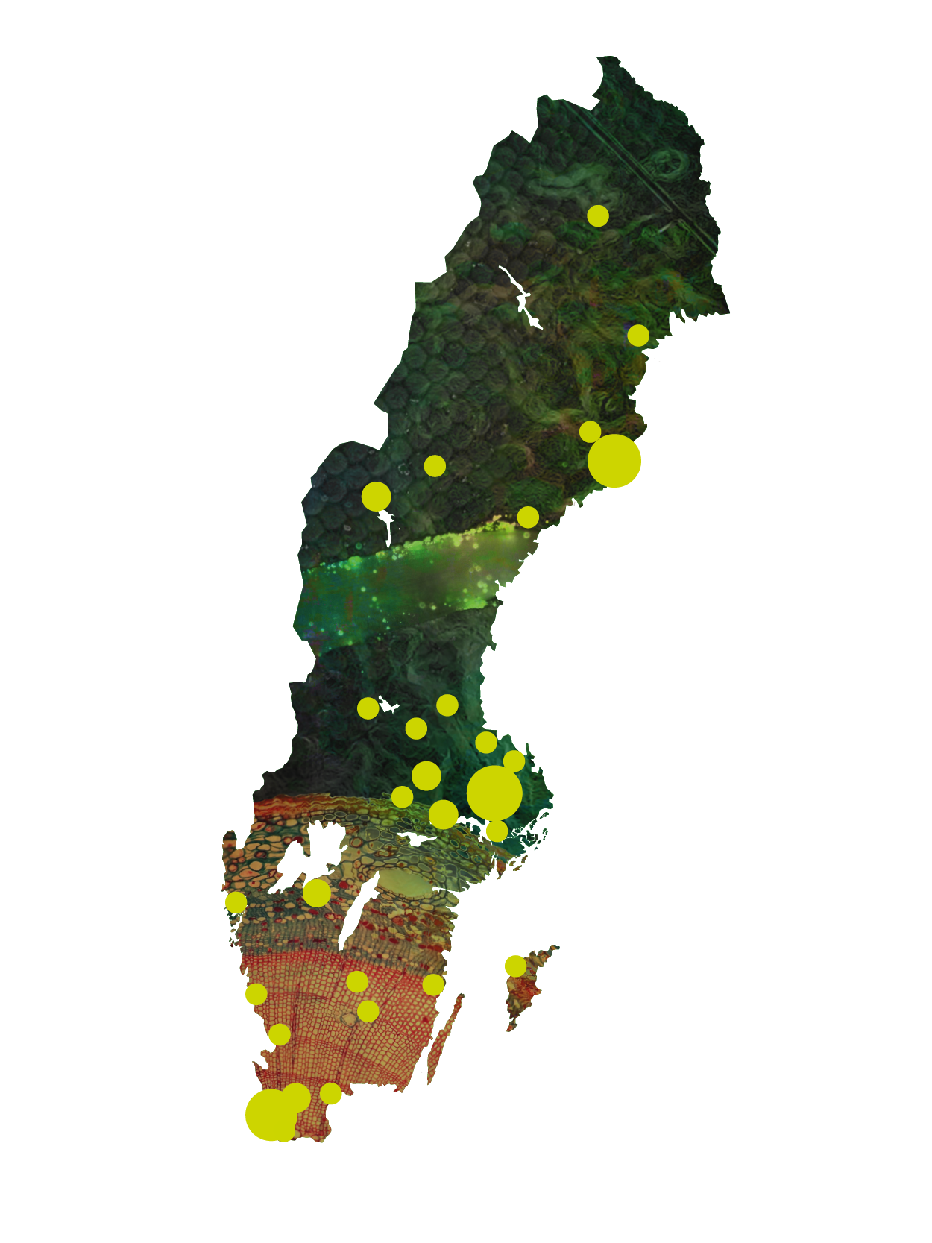
SLU IN SWEDEN
SLU is located at three principal locations in Sweden. We also conduct research, education, environmental assessment and collaborative activities at many research stations, experimental parks and campuses throughout Sweden.
Umeå
Uppsala
Alnarp
Notes:
SLU is located at three principal locations that are home to our four faculties:
Alnarp – the Faculty of Landscape Architecture, Horticultural and Crop Production Science
Umeå – the Faculty of Forest Sciences
Uppsala – the Faculty of Natural Resources and Agricultural Sciences and the Faculty of Veterinary Medicine and Animal Science
We also conduct research, education, environmental assessment and collaborative activities at many research stations, experimental parks and campuses throughout Sweden. (Please observe that the map is simplified and only illustrates that SLU is situated all over Sweden.)
We also have many international exchange schemes for students and researchers.
Read more at: https://www.slu.se/en/about-slu/visit-slu/locations-and-campuses/

Slide 18
SLU IN FIGURES
4,251 FULL-TIME STUDENTS
577 DOCTORAL STUDENTS
164 PROFESSORS
3,296 FULL-TIME EMPLOYEES
55 DEGREE PROGRAMMES
4,800 MILLION IN TURNOVER 2025 (Sek)
Notes:
SLU in figures in 2025:
For more facts & figures, see: https://www.slu.se/en/about-slu/about-the-university/slu-in-figures/

Slide 19
EXPENDITURE 2025
Environmental monitoring and assessments 13%
Education 19%
Breakdown of expanditure:
68% Research and doctoral education
19% Undergraduate and Master’s courses and programmes
13% Environmental monitoring and assessment
Research 68%
Notes:
SLU in figures
• Research and doctoral education 68 percent
• Undergraduate and Master’s courses and programmes 18 percent
• Environmental monitoring and assessments 14 percent
More info: https://www.slu.se/en/about-slu/about-the-university/slu-in-figures/

Slide 20
ORGANISATION
MINISTRY OF RURAL AFFAIRS
AND INFRASTRUCTURE
UNIVERSITY BOARD
INTERNAL AUDITING
UNIVERSITY
MANAGEMENT
SLU HOLDING AB
UNIVERSITY ADMINISTRATION
Faculty of Landscape Architecture, Horticultural and Crop Production Sciences
Faculty of Natural Resources and Agricultural Sciences
Faculty of
Veterinary Medicine and Animal Science
Faculty of
Forest Sciences
DEPARTMENTS
Notes:
SLU is the only higher education institution that comes under Sweden’s Ministry of Rural Affairs and Infrastructure (Landsbygds- och infrastrukturdepartementet).
The university consists of four faculties with around 30 departments and a number of administrative divisions. It also has a number of collaborative centres.
The faculties are called:
- Faculty of Landscape Architecture, Horticultural and Crop Production Science – situated in Alnarp
- Faculty of Natural Resources and Agricultural Sciences – situated in Uppsala
- Faculty of Forest Sciences – situated in Umeå
- Faculty of Veterinary Medicine and Animal Science – situated in Uppsala
SLU Holding is a wholly owned subsidiary with the purpose of stimulating commercialisation of innovations and entrepreneurship among scientists and students.
For more, see: https://www.slu.se/en/about-slu/organisation/

Slide 21
Thank you for your attention

