Slide 1
How to use this presentation
This presentation summarises the strategy.
Managers are encouraged to use this presentation when bringing their department, division or working group together to discuss how they can contribute to achieving the goals in the SLU strategy.
Feel free to add relevant examples from your area of operations to illustrate what is being done or planned within each focus area.

Slide 2
SLU´s strategy 2026–2030
Name, organisation

Slide 3
What the strategy is …
.. and what it is NOT
a guide and inspiration
support for prioritising and making decisions
a support for dialogue in management and working groups and our departments.
a checklist to tick off
an action plan for every part of the university
a list of requirements to fulfil.

Slide 4
Our mission statement
SLU conducts education, research and environmental monitoring and assessment in collaboration
with society at large.
Through our focus on the interaction between humans, animals and ecosystems and the responsible use of natural resources, we contribute to sustainable societal development and good living conditions on our planet.

Slide 5
Our vision
SLU plays a key role in development
for sustainable life, based on science
and education.

Slide 6

External challenges
Climate change and resource needs
Geopolitical instability and competition for resources
Rapid, disruptive technological development
Changing conditions for academia
Photo: NASA
Notes:
1. Climate change is one of the greatest challenges of our time. Access to important natural resources such as water, land and ecosystem services is changing, which in turn affects the conditions for sustainable living. Long-term efforts are needed to develop new knowledge and sustainable solutions. SLU plays a key role in analysing the consequences of climate change and developing strategies for climate adaptation, resource use and ensuring the functioning of ecosystems.
2. The global arena is characterised by shifting power dynamics and increased competition for both natural resources and expertise, which can affect both democracy and academic freedom. Universities play an important role in safeguarding scientific principles and providing knowledge that strengthens resilient social structures.
3. Rapid advances in automation, artificial intelligence and precision technology are creating new opportunities in SLU's areas of expertise. At the same time, new challenges are emerging in areas such as cyber security, information reliability and digital integrity, which require robust strategies to protect and quality-assure research, education and data that is important to society. SLU needs to develop and implement new technology and work to ensure that this is done responsibly and sustainably.
4. Research policy and views on academic autonomy are changing, both nationally and globally. Higher education institutions are affected by factors such as changing funding models, resource-intensive research infrastructure, increasing administrative demands and a change in trust in science and academic institutions. For SLU, it is crucial to remain a strong and independent player that ensures that our activities maintain quality, relevance and long-term sustainability

Slide 7
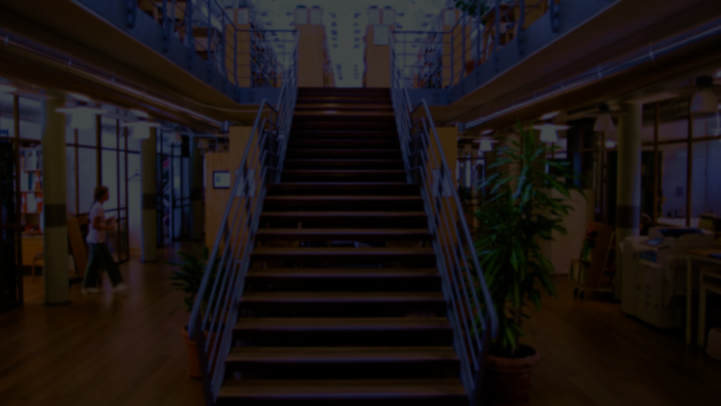
Three prioritised focus areas
SLU´s next steps towards sustainable development
SLU and the data-driven present and future
One SLU – We at SLU
Two overarching principles
Quality • Resource efficiency

Slide 8
SLU´s strategy 2026–2030
The three focus areas
The strategy yesterday and tomorrow
Discussion
Notes:
Let’s take a closer look at each of the focus areas and their objectives.

Slide 9

SLU´s next step towards sustainable development
Excellence and relevance in research, education and environmental assessment, strengthening the attractiveness of our degree programmes.
A leading global position in resilient ecosystems, future-proof sustainable crop production systems and One Health.
Driving innovation and competitive solutions for sustainable living in international collaborations.
Objective
SLU and the data-driven present and future
Develop and implement data-driven solutions using our expertise or strategic partnerships.
Continually strengthen our digital infrastructure.
Responsibly integrate digital and AI-based tools into programmes and courses.
Quality • Resource efficiency
Strategy
Objective
One SLU – We at SLU
Offer an inclusive work and study environment that builds pride, engagement and participation.
Strengthen shared responsibility and understanding of our mission through cohesive, strategic communication.
Focus on the three pillars of sustainability for long-term development.
Objective

Slide 10
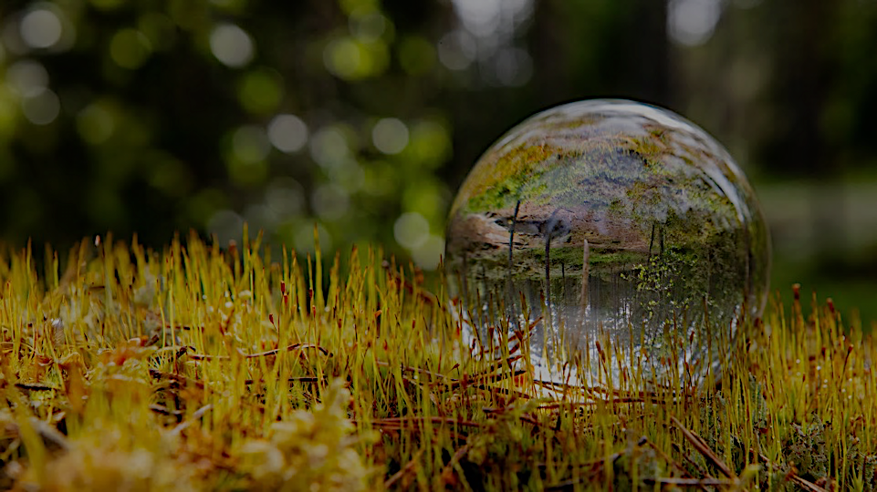
SLU´s next steps towards sustainable development

Slide 11


SLU's next steps towards sustainable development
Objective 1. SLU will meet the sustainable society's need for skills provision and knowledge through increased relevance and excellence in all three areas of activity: education, research and environmental monitoring and assessment. Based on the current skills needs in our areas, we create the conditions for sustainable skills provision. Efforts to strengthen the attractiveness of our degree programmes need to be further developed. Another priority is to continually ensure that the courses and programmes we offer and the formats they are made available in are to students and society, and that they meet the needs of lifelong learning throughout a person's professional life.

Slide 12
SLU's next steps towards sustainable development
Objective 2. SLU will be a leading source of knowledge for sustainable living. With our collective expertise and by promoting groundbreaking research, we contribute to competitiveness, food security and innovation for the bioeconomy of the future. Based on our areas of scientific excellence and strong societal needs, we aim to become the international leader in resilient ecosystems, future sustainable crop production systems and One Health.
Notes:
With scientific excellence in our areas and with a particular focus on areas where there is a great need in the world around us, SLU strives to strengthen its international position. We intend to take a leading global position in resilient ecosystems, sustainable crop production systems of the future and One Health.

Slide 13
SLU’s next step towards sustainable development
Objective 3. Through the power of change and innovative thinking, SLU will take the next steps in driving forward innovation and competitive solutions for sustainable living. Important tools include further developed meeting places, interdisciplinary working methods, a systems perspective and international collaboration.

Slide 14
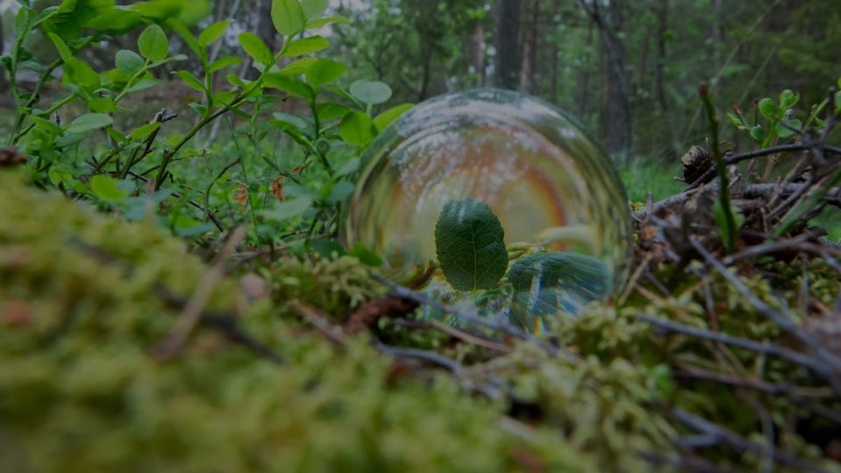
SLU and the
data-driven
present and future

Slide 15
SLU and the data-driven present and future
Objective 1. SLU will develop and implement data-driven solutions grounded in and informed by the areas in which we have our strongest digital expertise. SLU will also build on the the strategic collaborations that are necessary to achieve this.

Slide 16
SLU and the data-driven present and future
Objective 2. SLU will further and continually strengthen its digital infrastructure, security and associated support expertise. Today's universities have a rapidly growing need for digital infrastructure, and SLU faces particular challenges in this regard with its geographically dispersed and varied activities and large volumes of environmental data. This will enable us to create broad conditions for innovation, development, quality assurance and resource efficiency in our activities.

Slide 17
SLU and the data-driven present and future
Objective 3. SLU will responsibly integrate digital and AI-based tools into its programmes and courses, and also ensure that the experts of the future have the necessary skills. Today's teaching can be supplemented with innovative digital learning environments, interactive platforms and advanced visualisation techniques. Flexibility in terms of time and/or place can contribute to lifelong and individually tailored learning.

Slide 18

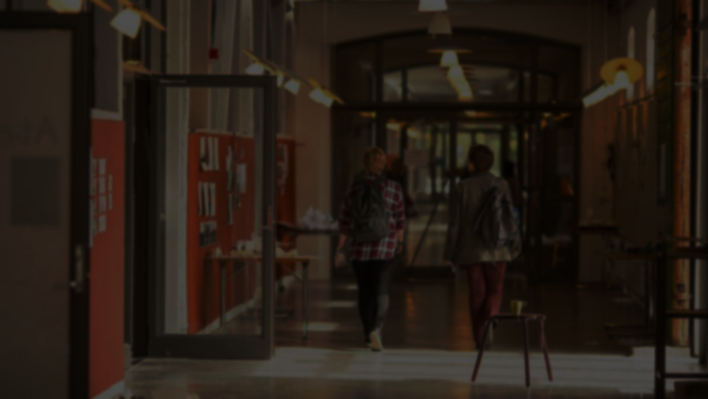
One SLU – We at SLU

Slide 19
One SLU – We at SLU
Objective 1. SLU will offer an inclusive work and study environment that fosters a sense of pride, commitment and participation throughout the university.
By providing more equal opportunities for professional development for staff and students, and through clear leadership and employeeship, we promote cohesion and long-term skills provision and strengthen the university's attractiveness.

Slide 20
One SLU – We at SLU
Objective 2. SLU will create conditions for shared responsibility and understanding of our common mission – from the local to the strategic level. SLU will also raise awareness and increase knowledge of our national mission in society. Strengthened, cohesive strategic communication increases the opportunities for everyone at SLU to make a contribution.

Slide 21
One SLU – We at SLU
Objective 3. As a place of study and work, SLU will be a pioneer socially, financially and ecologically to ensure that sustainability work is better integrated into its activities. Through a balanced focus on the three pillars of sustainability in campus development, resource use, support processes and infrastructure utilisation, we create the conditions for high quality and long-term development.

Slide 22
SLU´s strategy 2026–2030
The three focus areas
The strategy yesterday and tomorrow
Discussion

Slide 23
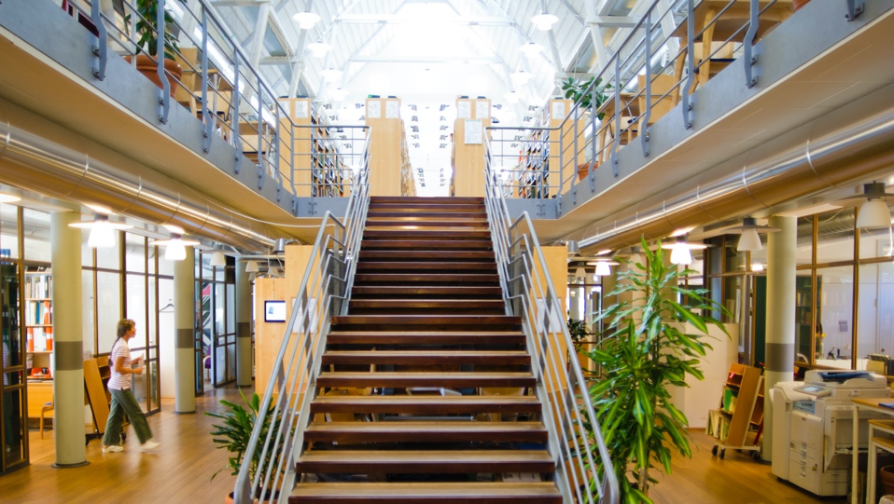
Vision
The strategy yesterday
Our next step for sustainable development
One SLU
SLU in the digital society
Our mission statement
Notes:
The focus areas were defined in the previous strategy. Both the vision and the mission statement were decided in conjunction with launching the previous strategy, and they remain in the new one.

Slide 24
Vision
The strategy tomorrow
SLU's next steps towards sustainable development
One SLU
– We at SLU
SLU and the data-driven present
and future
Our mission statement
Notes:
The three focus areas were defined in the previous strategy. What has happened since then is that SLU as a whole has moved up the stairs in several areas. The IT Infrastructure Upgrade Programme is one example, where we had to start from scratch upgrading our IT infrastructure. Today, we are much better prepared for the next step.

Slide 25
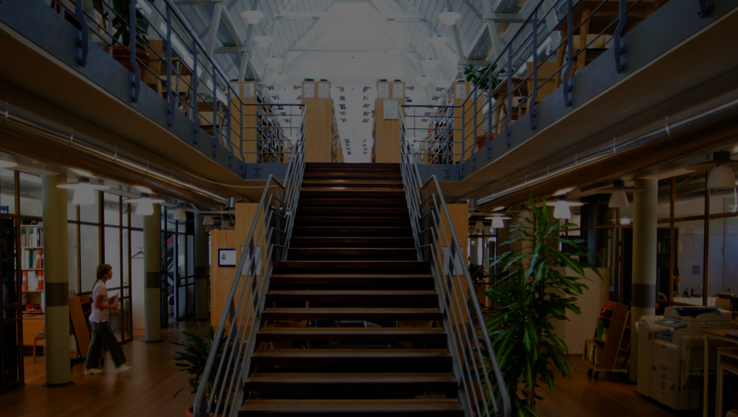
Vision
Quality and resource efficiency
SLU and the data-driven present
and future
SLU's next steps towards sustainable development
One SLU
– We at SLU
Our mission statement
Notes:
The SLU Board only decides on the university’s strategy, not about what research we conduct. This means that for members of staff, the strategy will be combined with whatever steps the faculty needs or wants to take to reach the vision and the objectives, and to make the decisions the focus areas bring with them.

Slide 26
SLU´s strategy 2026–2030
The three focus areas
The strategy yesterday and tomorrow
Discussion
Notes:
What discussions do we need to have to create an understanding of the strategy as a whole, as well as its individual components?

