Slide 1
Primer design

Slide 2
General rules for selecting GOI
It should be the gene of your interest
You need to have its sequence, preferably a full length sequence. Gene sequence is useful even if you are going to detect mRNA, you still want to know position of introns
If you are detecting mRNA you need to know, whether the gene of your interest has alternative splicing variants
You need to know if the gene of your interest has close homologues or conserved domains ( to avoid designing primers,which will recognise off-targets)

Slide 3
General rules for selecting reference genes
you want them to be equally expressed in control and test samples:
check available literature and ask people around
check available microarray data (follow this link: GENEVESTIGATOR)
figure out what genes are involved in key pathways in all cells present in your sample
avoid picking genes within the same pathway or cross-talking pathways
pick only single member family genes
choose the least conservative coding part of a gene you picked
it is on your conscience to trust single reference gene data. just for you information, good people use more than one reference.
sic! before designing primers read carefully manual of a qPCR kit you are going to use. Different kit shave different demands for optimal amplicons lengths

Slide 4
create an account and log in to the GENEVESTIGATOR
sic!!! you will need to install latest version of JAVA and allow it to run this software

Slide 5
video tutorial are very useful

Slide 6
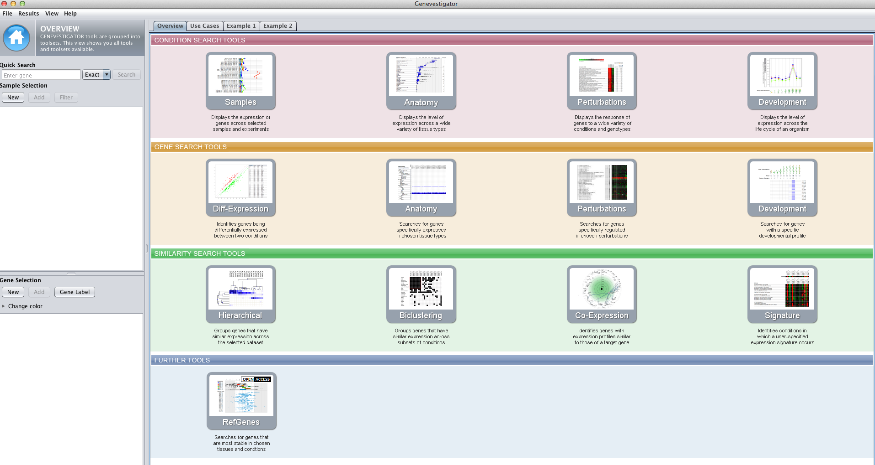
if you need to find reference genes you should use this tool

Slide 7
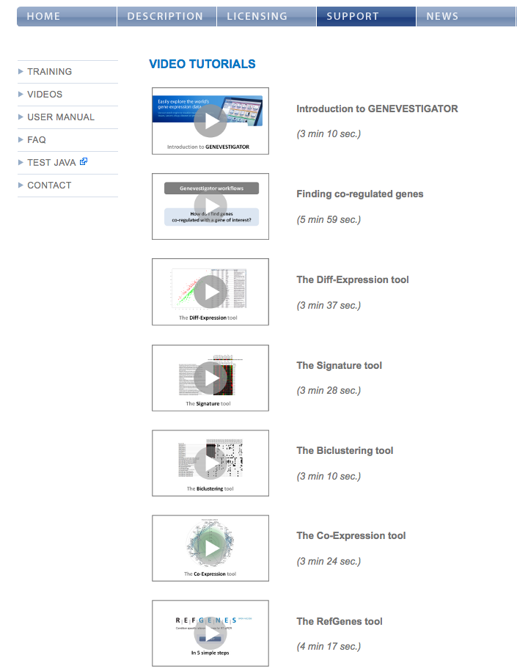
please go to the home page of genevestigator
click on tutorials
please watch this tutorial

Slide 8
General idea for designing PCR primers
untranslated region
exon 1
exon 2
exon 3
exon 4
promoter
5’ UTR
3’ UTR
terminator
eukaryotic gene structure
5’
3’
intron 1
intron 2
intron 3
transcription start
transcription stop
transcription
5’
5’ UTR
3’ UTR
3’
precursor mRNA
splicing
5’
5’ UTR
✁
✁
✁
✁
✁
3’ UTR
3’
✁
translation start
translation stop
coding DNA sequence
please note that this is RNA molecule, CDS is the corresponding part of the gene
5’
5’ UTR
3’ UTR
3’
mRNA
CDS
exon junction sites

Slide 9
General idea for designing PCR primers
designing primers within one exon
promoter
5’ UTR
3’ UTR
gene
5’
3’
Fw
Re
amplicon size if detecting genomic DNA
5’
5’ UTR
3’ UTR
3’
mRNA
Fw
Re
amplicon size if detecting mRNA
amplicons from gene and cDNA are of the same size
plus: primers can be used to detect both gene and its mRNA
minus:qPCR will not show you presence of genomic DNA contamination

Slide 10
General idea for designing PCR primers
designing primers spanning a large intron
promoter
5’ UTR
3’ UTR
gene
5’
3’
Fw
Re
amplicon size if detecting genomic DNA
5’
5’ UTR
3’ UTR
3’
mRNA
Fw
Re
amplicon size if detecting mRNA
amplicon from the gene is too large to be amplified during qPCR
amplicon from cDNA is fine
plus: you will amplify only your cDNA
minus:qPCR will not show you presence of genomic DNA contamination

Slide 11
General idea for designing PCR primers
designing primers spanning a small intron
promoter
5’ UTR
3’ UTR
gene
5’
3’
Fw
Re
amplicon size if detecting genomic DNA
5’
5’ UTR
3’ UTR
3’
mRNA
Fw
Re
amplicon size if detecting mRNA
amplicon from the gene is larger than amplicon from cDNA
plus: you will see if you have DNA contamination
minus:it is not always possible to find short enough intron

Slide 12
General idea for designing PCR primers
designing primers on exon junction site
promoter
5’ UTR
3’ UTR
gene
5’
3’
Fw
Re
one of the primers can’t anneal
no PCR product
5’
5’ UTR
3’ UTR
3’
mRNA
Fw
Re
amplicon size if detecting mRNA
primers do not anneal on gene at all
plus: you will amplify only your cDNA
minus:you will not see if you have DNA contamination

Slide 13
General rules for designing qPCR primers
optimal amplicon size more than 50 bp, but less than 250 bp (sic! for our kit! DyNAmo Flash SYBR Green qPCR)
GC content as close to 50%
length: not shorter than 18 ntp, preferably not longer than 30. 22-25 bp is usually good.
all primers should have approx. the same melting T (Tm)
check for self annealing and primer dimer formation
check for specificity, while doing it allow several mismatches
you can eliminate or detect genomic DNA contamination (intron-spanning primers)
make sure, that all your primers are written down as 5’->3’ (including the reverse one)
T/A on 3’ end might decrease not specific amplification
try Primer3 and BLAST-primer softwares (on the course site)

Slide 14
General idea for designing PCR primers
the template gene
5’
3’
sense strand
3’
5’
anti-sense strand=complementary strand
precursor of your Forward primer = a short piece of sense strand
5’
3’
3
5’
precursor of your Reverse primer = a short piece of complementary strand
3’
5’
5’
3’
you have to submit sequences of your primers in a form 5’ -> 3’
precursor of your Forward primer is already 5’->3’
=> you do not need to change it
precursor of your Reverse primers 3’->5’
=> you need to reverse the sequence into 5’->3’
=> you will get a reverse complementary strand

Slide 15
General idea for designing PCR primers
the template gene
with an example sequence
5’
AATGAC
GTTACC
3’
sense strand
3’
5’
anti-sense strand=complementary strand
TTACTG
CAATGG
precursor of your Forward primer = a short piece of sense strand
AATGAC
5’
3’
3
5’
TTACTG
precursor of your Reverse primer = a short piece of complementary strand
CAATGG
3’
5’
5’
3’
GTTACC
you have to submit sequences of your primers in a form 5’ -> 3’
precursor of your Forward primer is already 5’->3’
=> you do not need to change it
AATGAC
Fw primer: AATGAC
5’
3’
precursor of your Reverse primers is written 3’->5’
=> you need to reverse the sequence into 5’->3’
=> you will get a reverse complementary strand
CAATGG
GGTAAC
3’
5’
5’
3’
Re primer: GGTAAC
please note, that your primers must be much longer!!

Slide 16
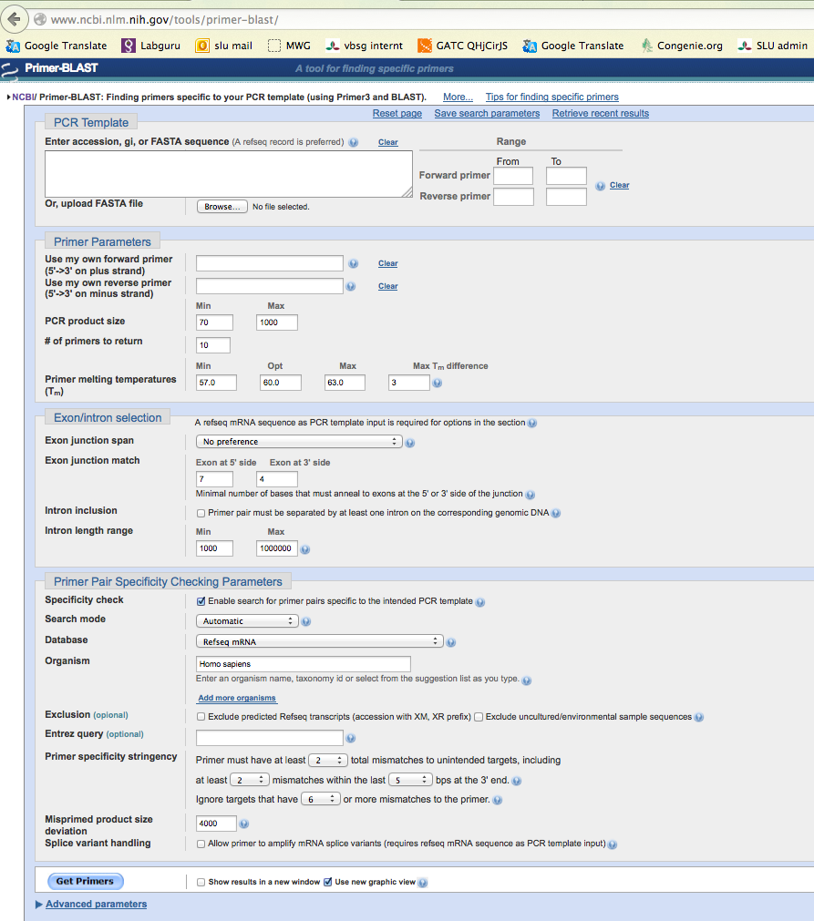
Primer-BLAST
1. enter here the sequence of your gene, or its reference number from NCBI database
2. if you know which part of the gene you want to detect, type the approximate position here. Or leave it empty
3. leave these empty,since you do not know the sequence of your primers yet
5. start with Tm=60ºC, allow about 2-3 ºC difference. Remember, that ALL your qPCR primers should have the same Tm, you will run ALL reactions on the same plate simultaneously using the same protocol.
4. for qPCR you want amplicon size= 50-250 bp
6. consider these options, if you want to avoid detection of DNA contamination
7. consider these options, if you want to span intron
9. get your primers
8. select the organism you work with and run specificity check for your primers, allow at least several mismatches!
qPCR will not allow amplification of products longer than 1 kb
10. if you got more than 1 primer pair, consider which one suits your requirements the best (see slide 13)

Slide 17
Primer-BLAST
you can also use primer-blast to check specificity of already designed primers
1. pase sequences of your primers
3. run the specificity test
2. select the organism you work with and run specificity check for your primers, allow at least several mismatches!
qPCR will not allow amplification of products longer than 1 kb

Slide 18
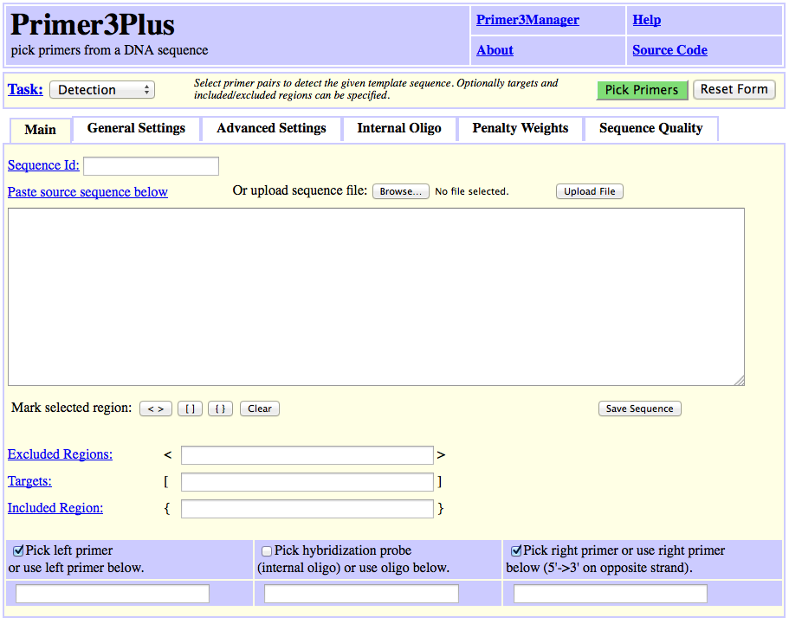
Primer3Plus
try to play with it by yourself

